Slide 1

Computer Networks
Lesson 3

Slide 2

Session Objectives
Describe computer networks and their pros and cons
Explain the different ways networks are defined
Describe the types of transmission media used in networks.
Differentiate Internet and Intranet
Network security

Slide 3
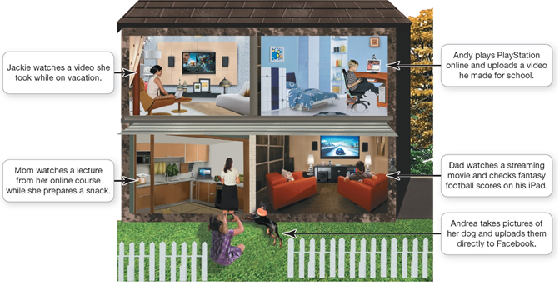
The Jargons
Computer network
Node
Computer
Peripheral
Network device
Transmission media
Hub

Slide 4
Benefits and Challenges of networks
Benefits
Sharing a high-speed Internet connection
Sharing printers and peripheral devices
Sharing files
Common communications
Disadvantage of networks
Setup and administration
Increased security and privacy threat

Slide 5

How data moves through networks
Data transfer rate (bandwidth) is the maximum speed data can be transmitted
Throughput is the actual speed data is transferred
Measured in megabits per second (Mbps) or gigabits (Gbps)

Slide 6
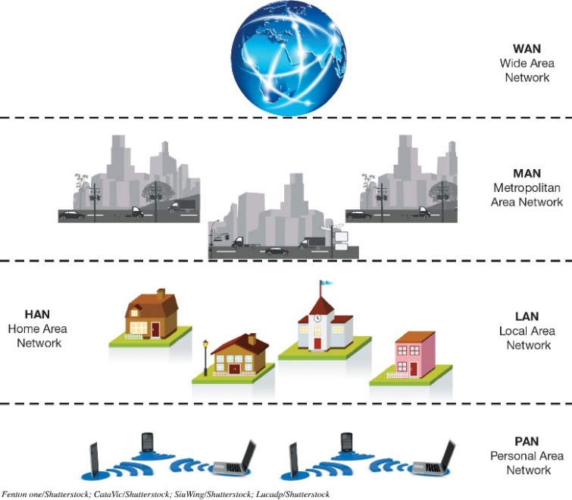
Network Architectures Network Designs
Networks can be classified by distance
Personal area network (PAN)
Local area network (LAN)
Home area network (HAN)
Metropolitan area network (MAN)
Wide area network (WAN)

Slide 7
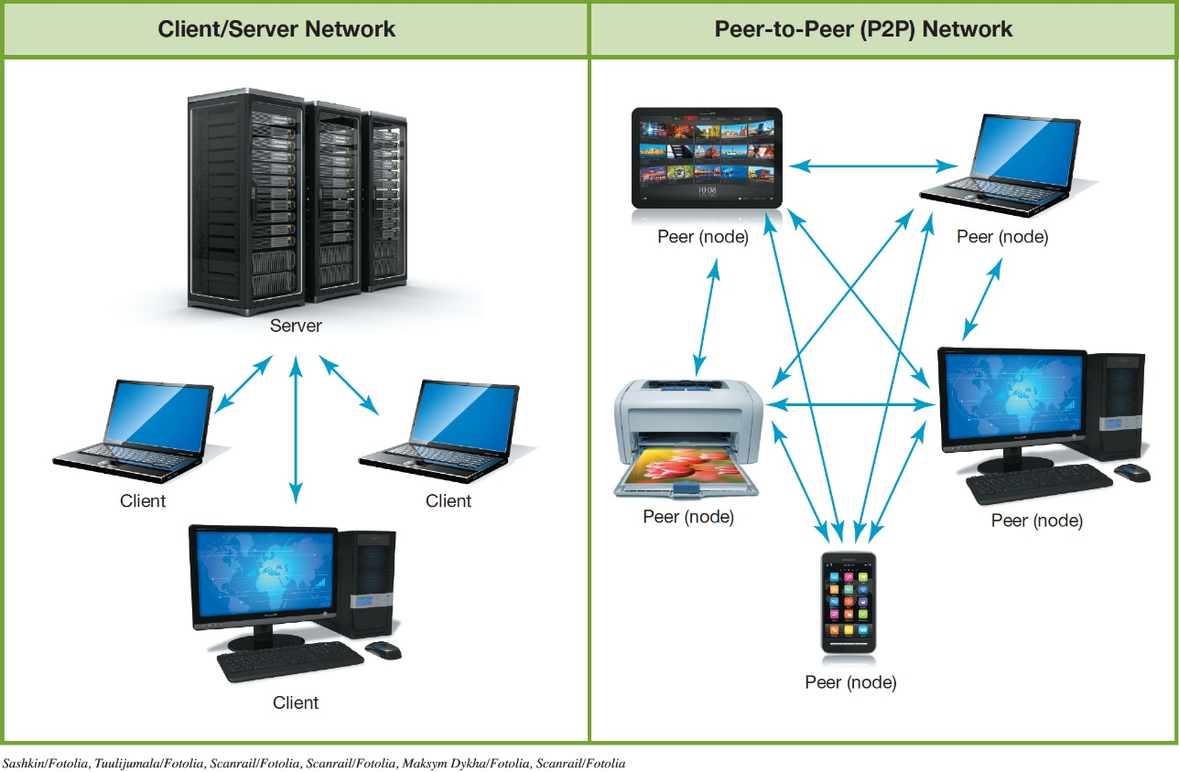
Networks can be classified by levels of administration
Client/server network
Peer-to-peer (P2P) network

Slide 8
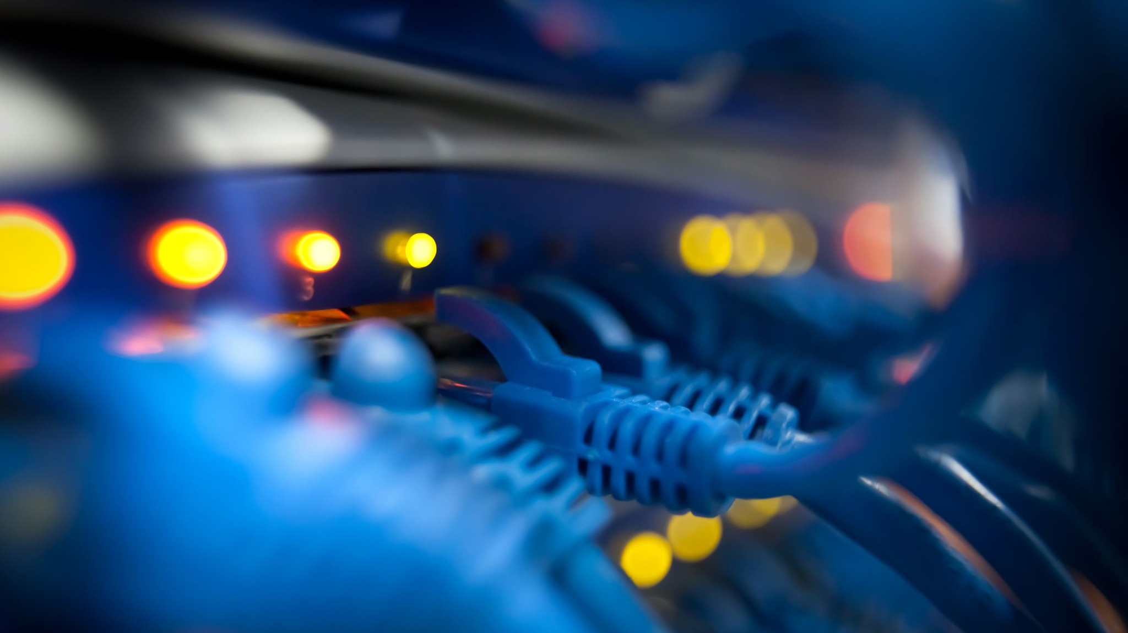
Network Architectures Network Designs
Networks can be classified by the protocols used
Ethernet
Developed by the Institute of Electrical and Electronics Engineers (IEEE)
Wireless networks (Wi-Fi)
Wired networks (gigabit Ethernet (GbE))
Backwards compatibility
Notes:
Networks can be classified by the protocols used.
Ethernet
Developed by the Institute of Electrical and Electronics Engineers (IEEE).
This applies to wireless and wired networks.
The ability of current devices to use earlier standards in addition to the current standard is known as backward compatibility.

Slide 9
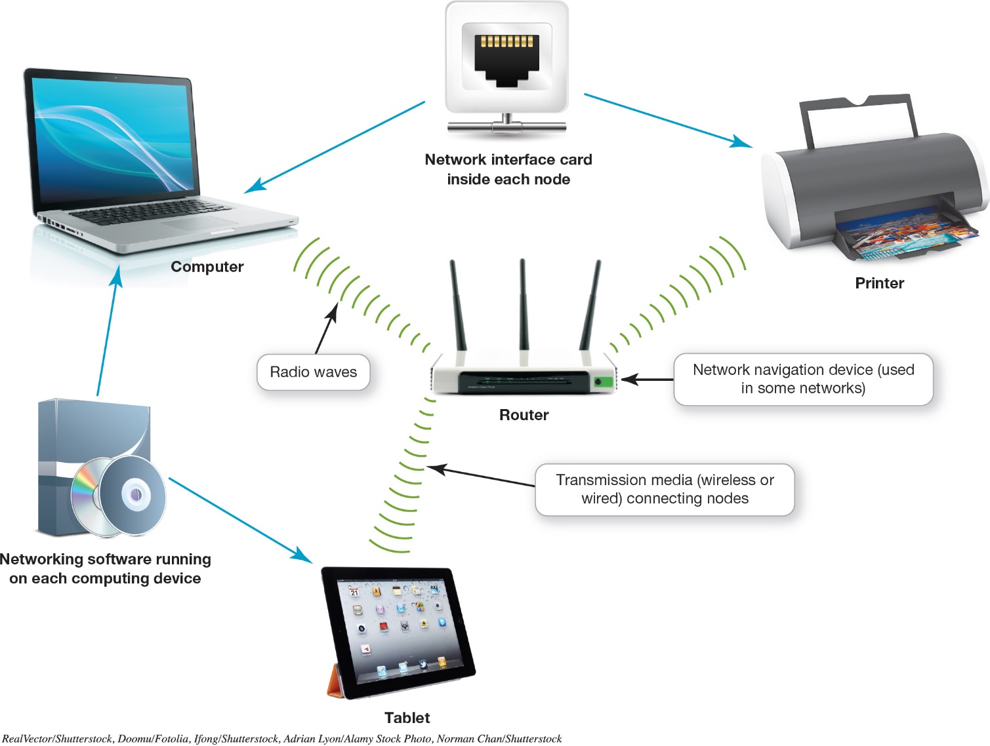
Network Components
Notes:
In order to function, all networks must include:
A means of connecting the nodes on the network—cables or wireless technology.
Special hardware devices that allow the nodes to communicate with each other and to send data.
Software that allows the network to run.

Slide 10
Network Components Transmission Media
Transmission media establish a communications channel between the nodes on a network.
Wireless networks
Wired networks
Notes:
Transmission media establish a communications channel between the nodes on a network. They can be either wireless or wired.

Slide 11
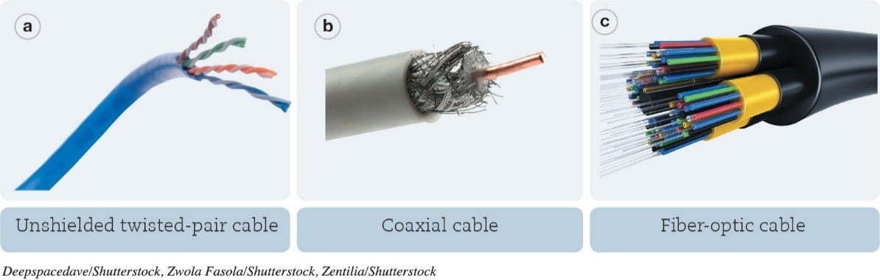
Network Components Transmission Media
Wired
UTP cable – twisted copper wires surrounded by a plastic jacket
Coaxial cable – single copper wire surrounded by layers of plastic
Fiber-optic cable – plastic or glass fibers
Notes:
Wired networks can use the following media:
UTP cable – twisted copper wires surrounded by a plastic jacket.
Coaxial cable – single copper wire surrounded by layers of plastic.
Fiber-optic cable – plastic or glass fibers.

Slide 12
Network Components Basic Network Hardware
Network adapter
Network interface card (NIC)
Modem
Router
Switch
Internet of Things (IoT)
Notes:
Each node needs a network adapter. An integrated network adapter is referred to as a network interface card.
A broadband connection requires a modem, which translates the signal into digital and back again.
Data is sent in bundles called packets.
Network navigation devices facilitate and control the flow of data.
A router transfers packets of data between two or more networks.
A switch acts like a traffic signal on a network.
The IoT is defined as the interconnection of uniquely identifiable embedded computing devices that transfer data over a network without requiring human-to-human or human-to-computer interaction.

Slide 13
Network Components Network Software
Operating system for P2P networking
Client/server network
Communicate through centralized server
Specialized network operating system (NOS) software
Notes:
Because home networks are P2P networks, they need operating system software that supports P2P networking.
As opposed to P2P networks, the nodes on a client/sever network don’t communicate directly with each other; rather, they communicate through a centralized server. Communicating through a server is more efficient in a network with a large number of nodes, but it requires more complex software. Therefore, servers on client/server networks have specialized network operating system (NOS) software installed.

Slide 14
10 minutes break

Slide 15

Connecting to the Internet Broadband Internet Connections (1 of 2)
Home network
Share an Internet connection
Must purchase Internet access from ISP
Specialized providers
Companies that provide other services
Broadband
Cellular or Dial-up
Notes:
One of the main reasons for setting up a network is to share an Internet connection. Some businesses and large organizations have a dedicated connection to the Internet, but other businesses and homeowners purchase Internet access from Internet service providers (ISPs). ISPs might be specialized providers.
Broadband is the preferred way to access the Internet, but in some situations cellular or dial-up access might be necessary.

Slide 16
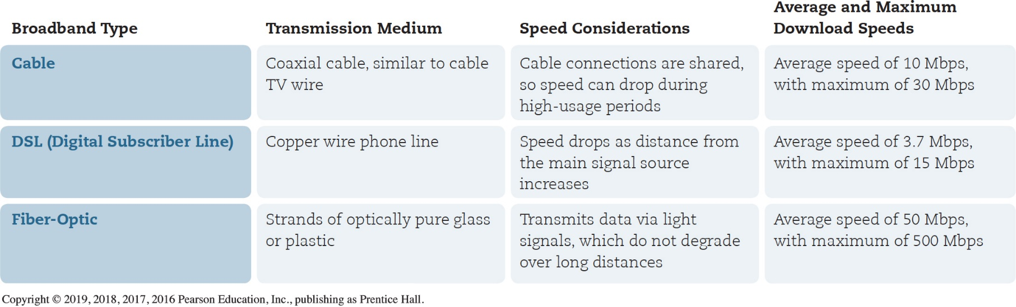
Connecting to the Internet Broadband Internet Connections (2 of 2)
Broadband
Cable Internet
DSL (digital subscriber line)
Fiber-optic service
Satellite Internet
Notes:
Broadband is often referred to as high-speed Internet. This high rate of access is in contrast to dial-up Internet access.
The standard wired broadband technologies in most areas are cable, DSL, and fiber optic service.
Satellite Internet is used mostly in rural or mountain areas.

Slide 17
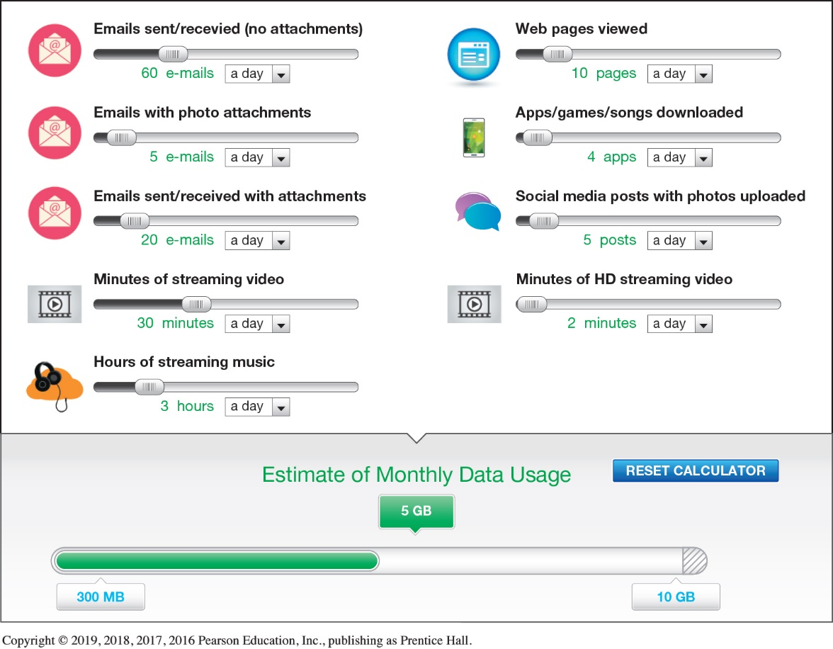
Connecting to the Internet Wireless Internet Access (Objective 7.7)
Mobile broadband
Wireless Internet at home
Mobil hotspot
Wireless ISP
Data plan
Notes:
To access the Internet wirelessly at home, you need to establish WiFi on your home network by using a router.
When away from home, you can find a Mobil hotspot.
Mobile broadband connects you to the Internet through 3G or 4G access.
You must have a wireless Internet service provider.
An Internet connectivity plan is known as a data plan.

Slide 18

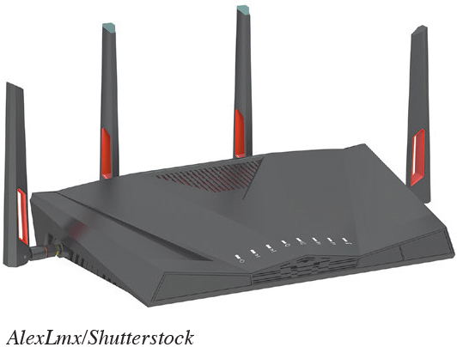
Installing and Configuring Home Networks Planning Your Home Network
List all the devices you are using
Use the latest standards
Use the newest equipment
Notes:
One of the first things you should do to evaluate your network is list all the devices you’re using.
For a home network to run most efficiently and to provide the fastest experience, it’s best that all network nodes use the latest Ethernet standard.
If your router is provided by your ISP and it’s an older standard, you should consider having your ISP provide you with a new router.

Slide 19
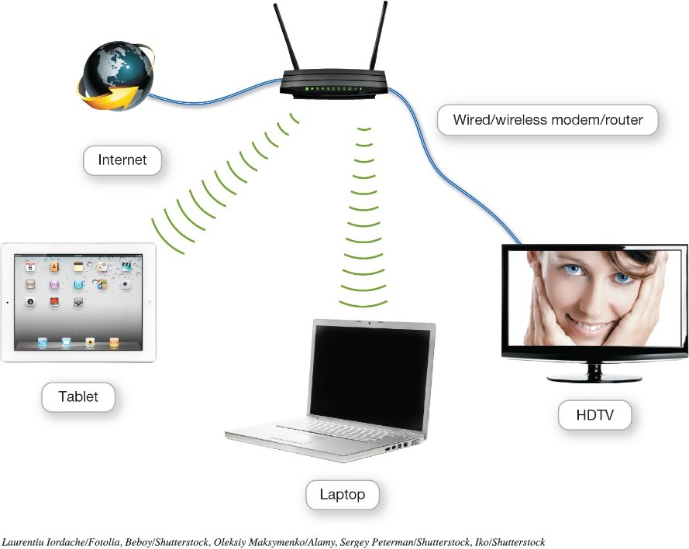
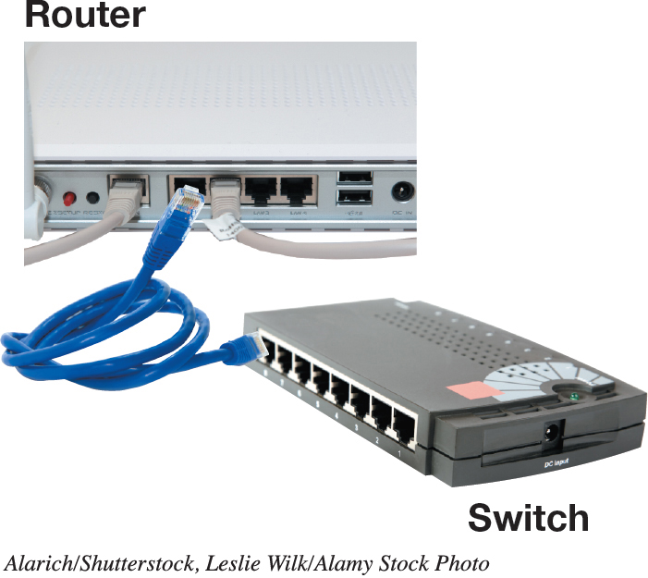
Installing and Configuring Home Networks Connecting Devices to a Network (1 of 2)
Routers
Switches
Notes:
All routers that support the 802.11n standard (and newer 802.11ac) should work with computers running Windows or OS X. However, Apple has designed routers that are optimized for working with Apple computers.
Windows machines can also connect to an AirPort router, so it’s a great choice for households with both Apples and PCs.
The AirPort Express router can be used for home networks to support devices running iOS, macOS, and Windows.
A switch acts like a traffic signal on a network.

Slide 20
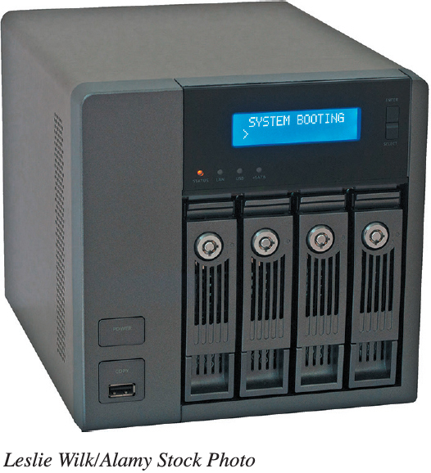
Installing and Configuring Home Networks Connecting Devices to a Network (2 of 2)
Specialized Home Networking Devices
Network Attached Storage (NAS) devices
Home network servers
Network-ready device
Notes:
There are specialized home networking devices.
Network-attached storage (NAS) devices are specialized devices designed to store and manage network data. NAS devices provide centralized data storage and access.
Home network servers are specialized devices designed to store and share files across the network.
A network-ready device (or Internet-ready device) can be connected directly to a network through either a wired or wireless connection.

Slide 21
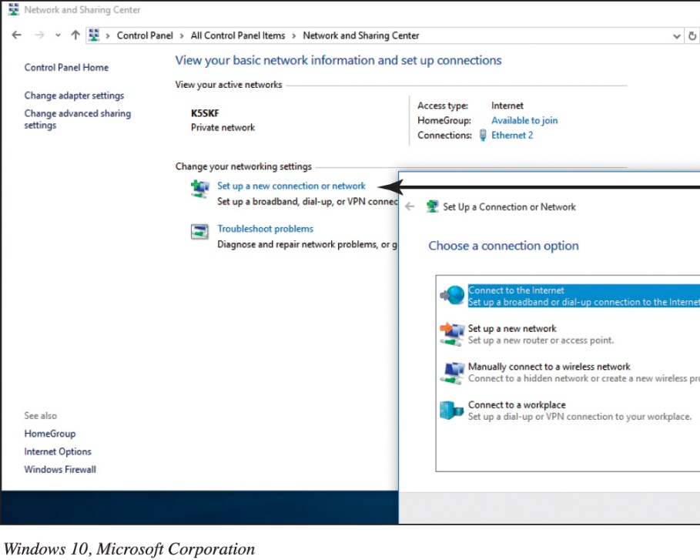
Installing and Configuring Home Networks Configuring Software for Your Home Network
Setting up a Windows based network
Sharing files
Connecting mobile devices
Notes:
In Windows, the process of setting up a network is fairly automated, especially if you’re using the same version of Windows on all your computers.
For ease of file and peripheral sharing, Windows has the HomeGroup feature.
Connecting a mobile device to a wireless network is an easy process, regardless of its operating system.

Slide 22
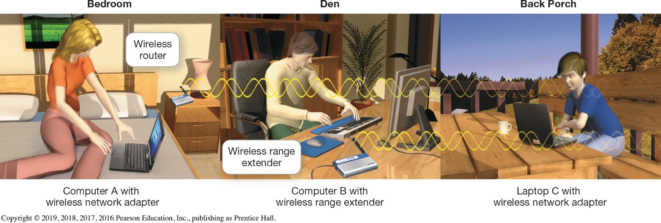
Managing and Securing Wireless Networks Troubleshooting Wireless Network Problems (
Range
Speed (throughput)
Range extender
Notes:
The maximum range of 802.11n or 802.11ac wireless devices is about 350 feet. But as you go farther away from your router, the speed (throughput) you achieve decreases.
Repositioning the node within the same room—sometimes even just a few inches from the original position—can affect communication between nodes.
A wireless range extender is a device that amplifies your wireless signal to extend to parts of your home that are experiencing poor connectivity.

Slide 23
Managing and Securing Wireless Networks Securing Wireless Networks (1 of 3)
Use encryption and security protocols
Change network name or Service Set IDentifier (SSID)
Disable SSID broadcast
Change the default password
Create a passphrase
Implement media access controls
Notes:
There are various issues and methods for securing your wireless network.
Use encryption and security protocols
Change network name (SSID)
Disable SSID broadcast
Change the default password
Create a passphrase
Implement media access controls

Slide 24


Slide 25
Managing and Securing Wireless Networks Securing Wireless Networks (2 of 3)
Limit signal range
Apply firmware upgrades
Disable remote access
Keep router firmware up to date
Notes:
Additional methods for securing your wireless network include:
Limit signal range
Apply firmware upgrades
Disable remote access
Keep router firmware up to date

Slide 26
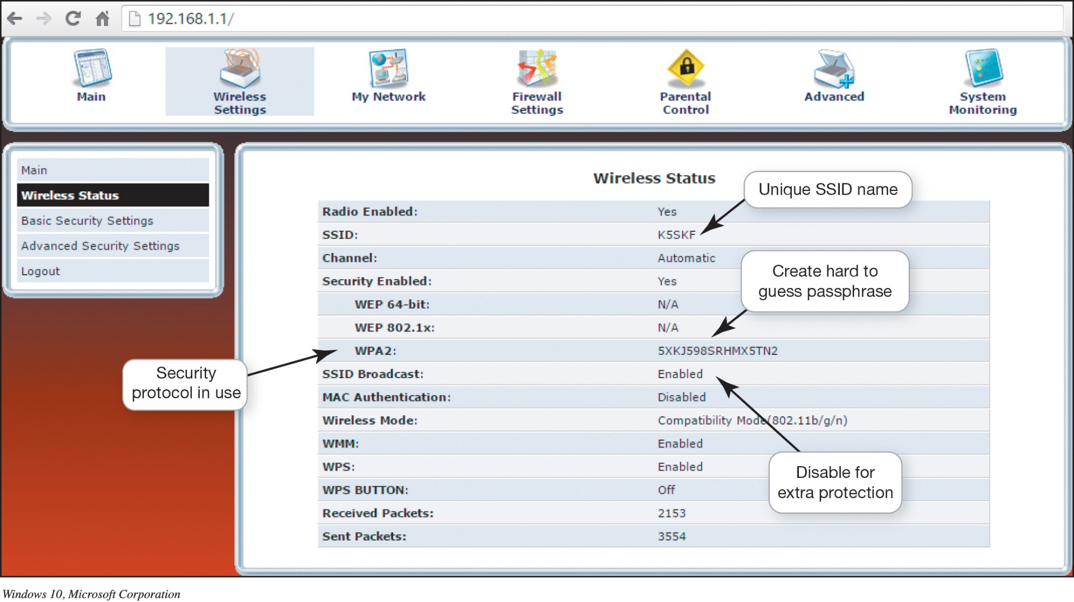
Managing and Securing Wireless Networks Securing Wireless Networks (3 of 3)
Notes:
By accessing your router, you can configure the security protocols available on your router and change the SSID.

Slide 27
The End

